Slide 1
Applications of Quadric Surfaces

Slide 2
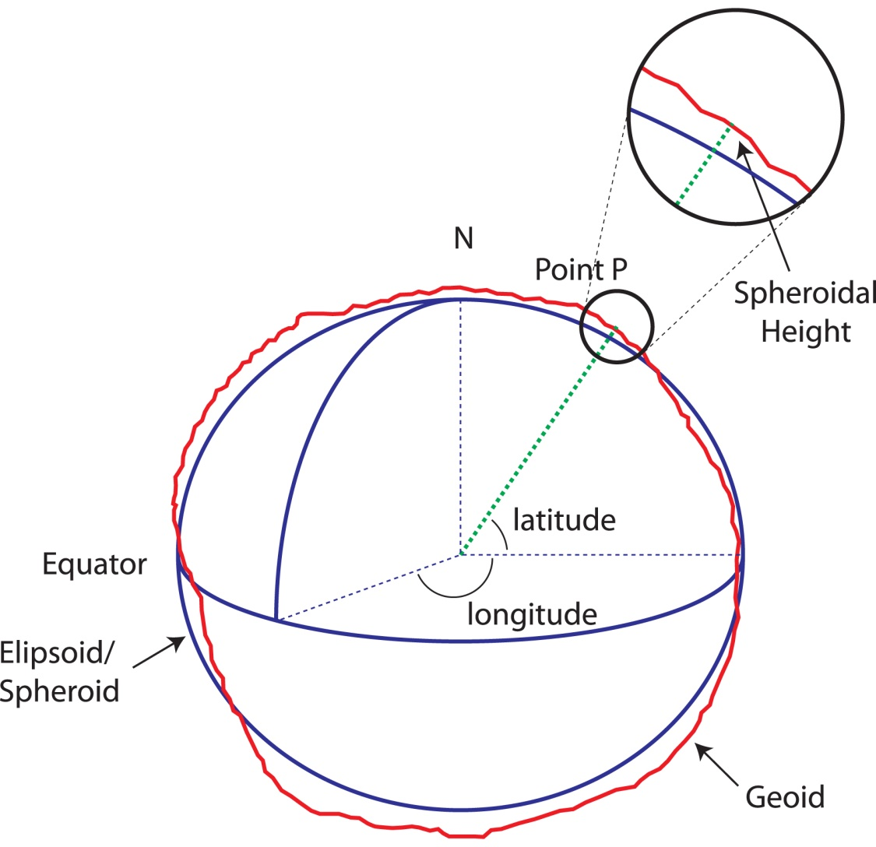
Planetary Ellipsoid

Slide 3
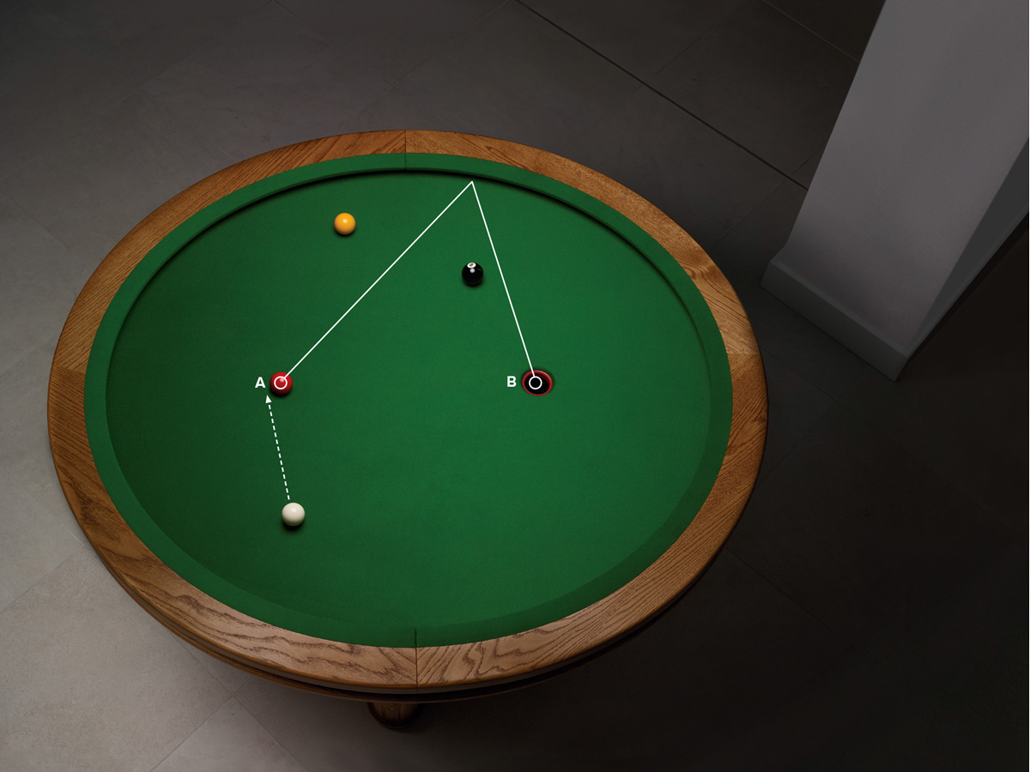
Elliptical Billiards

Slide 4
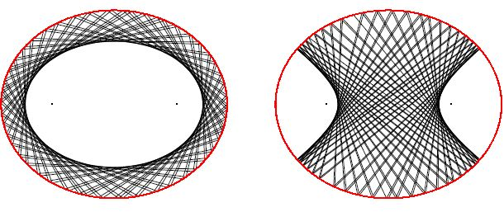
Elliptical Billiards

Slide 5
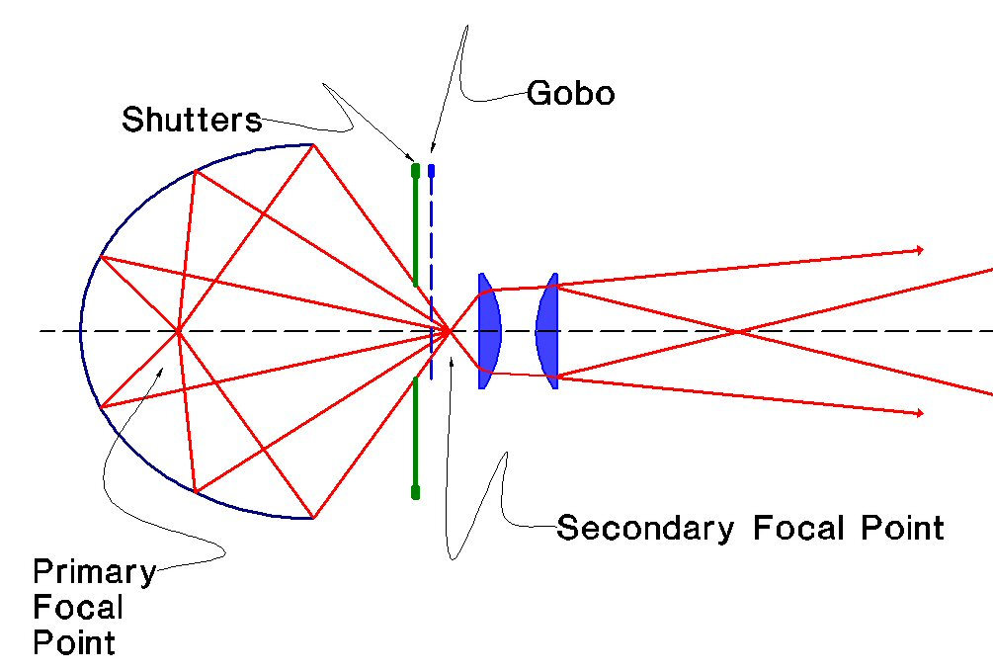
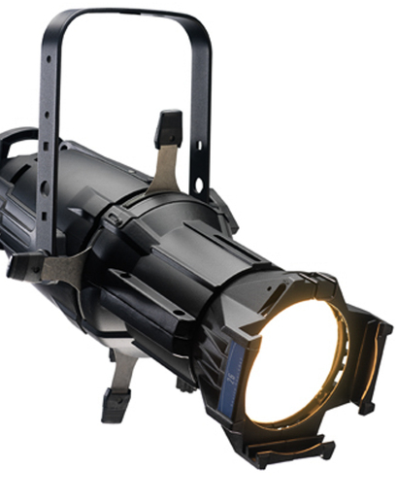
Ellipsoid Reflector Spotlights

Slide 6
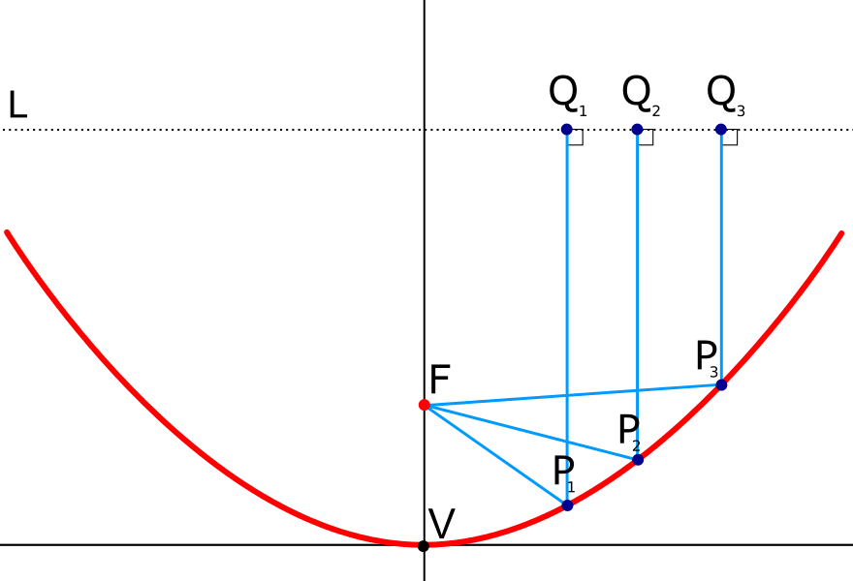
Parabolic Reflectors

Slide 7
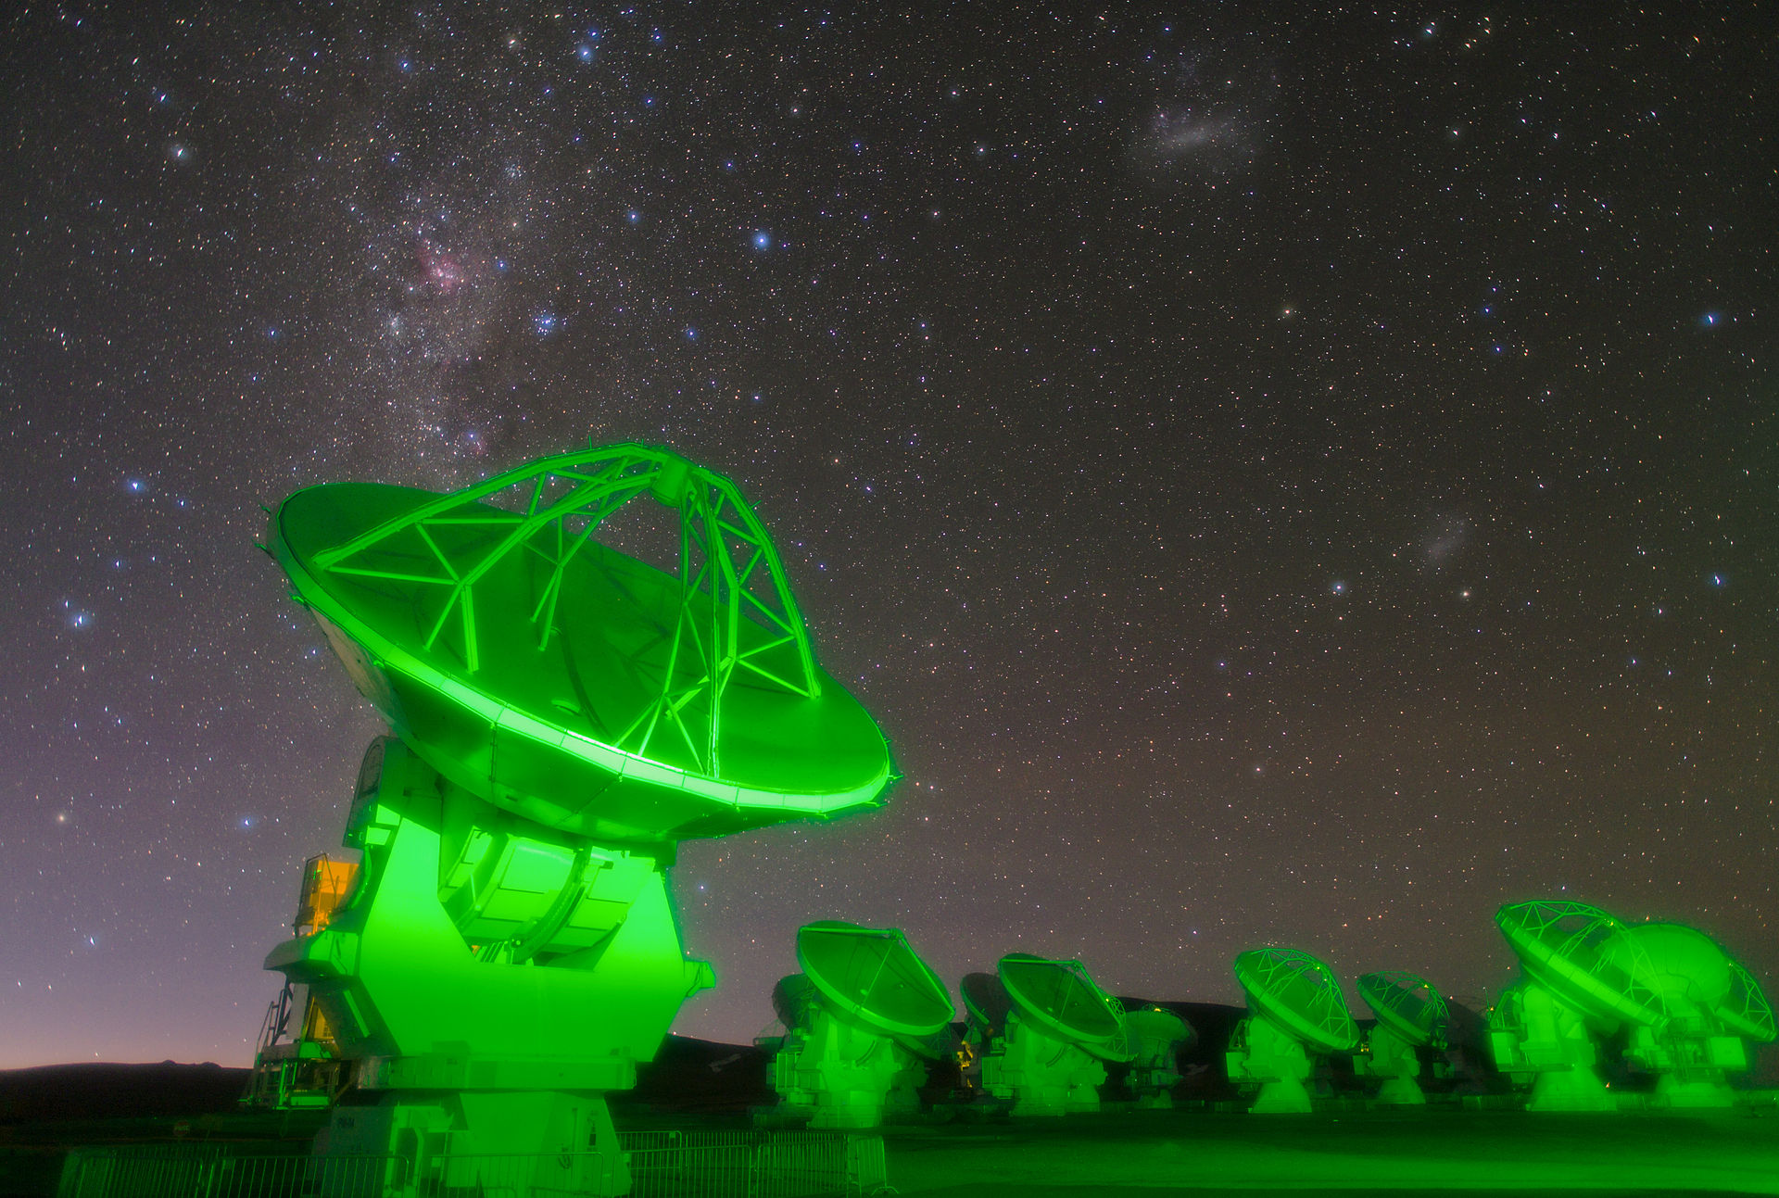
Parabolic Reflectors

Slide 8
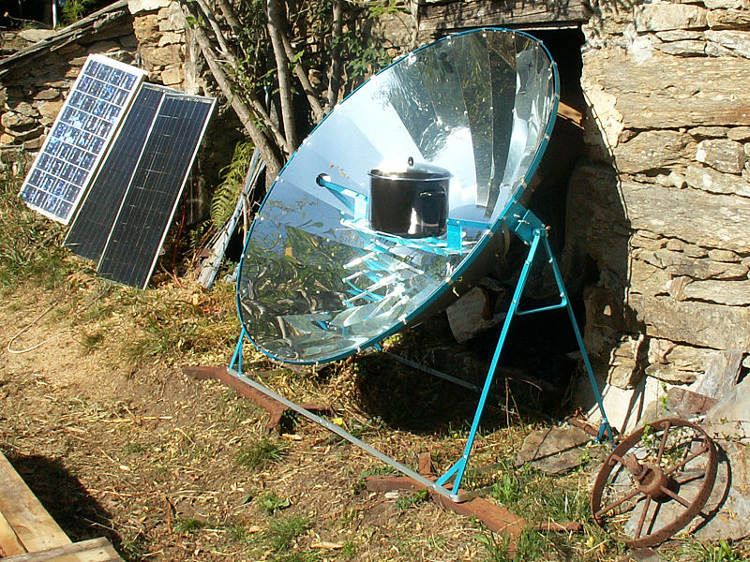
Parabolic Reflectors

Slide 9
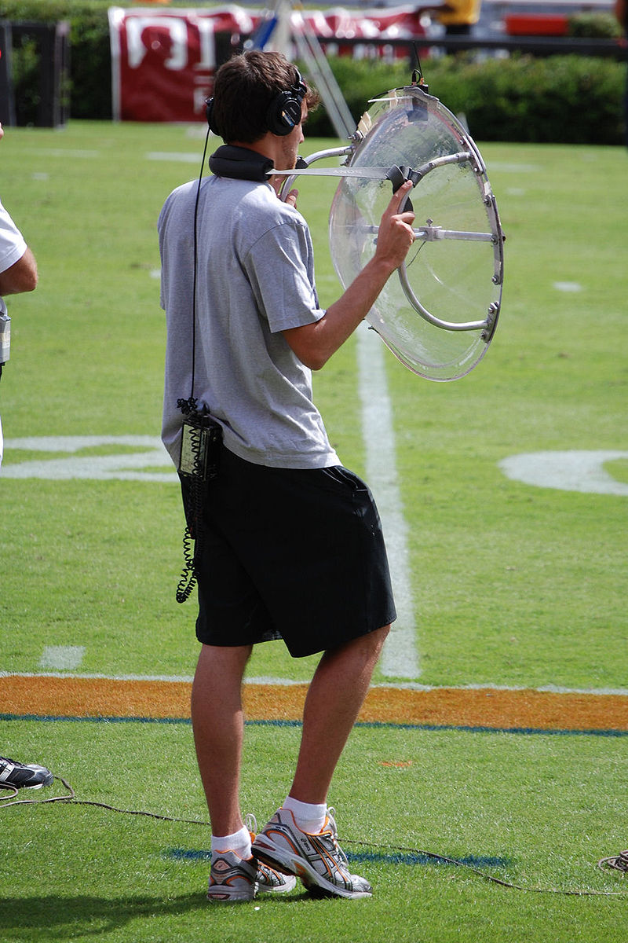
Parabolic Microphones

Slide 10
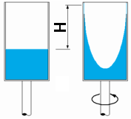
Rotating Fluids

Slide 11
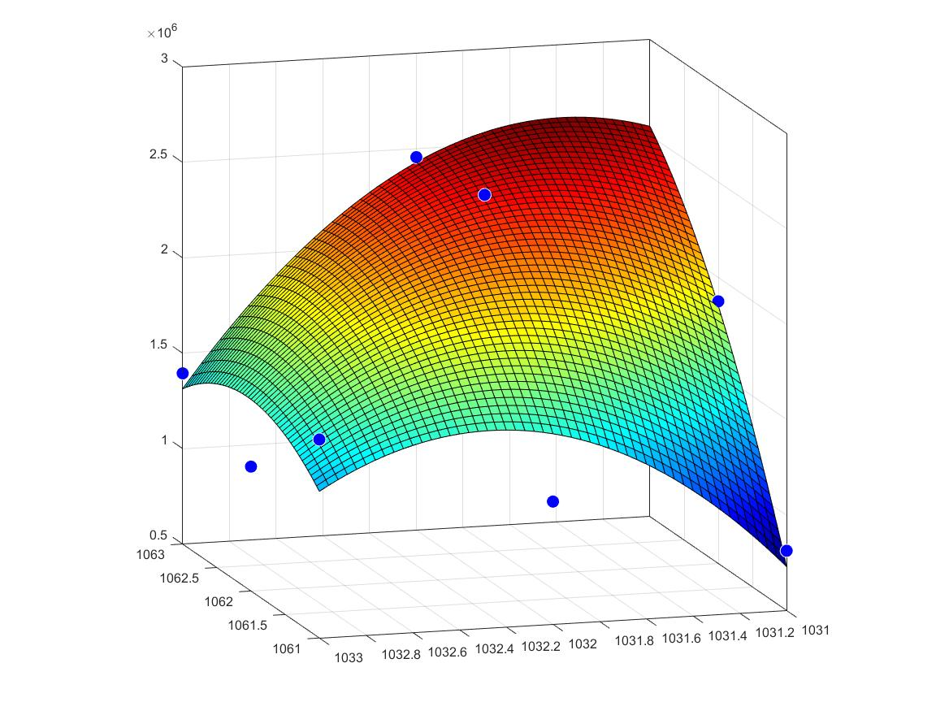
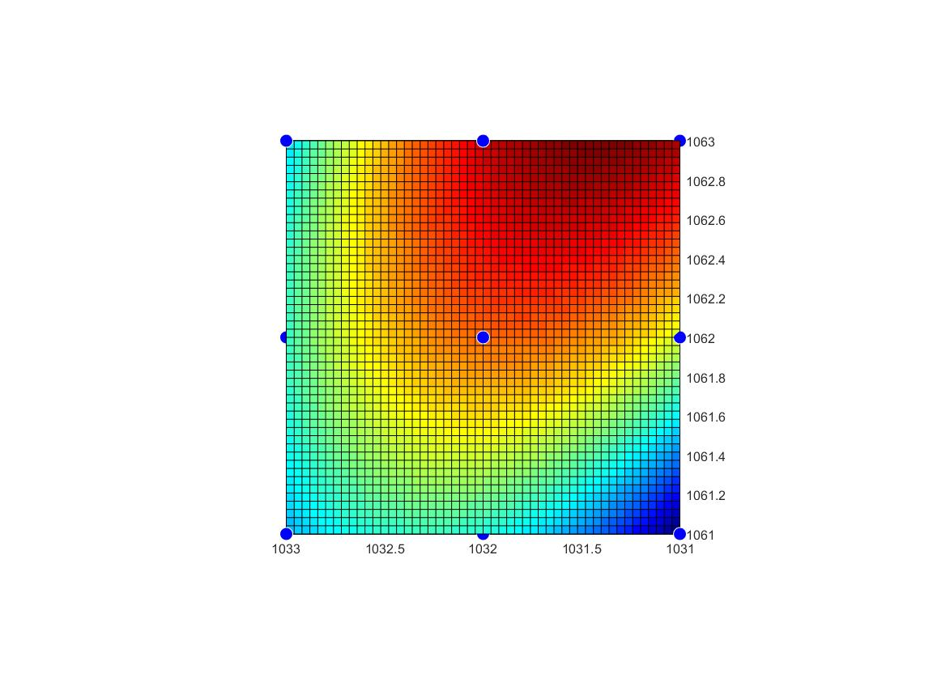
Image Analysis

Slide 12
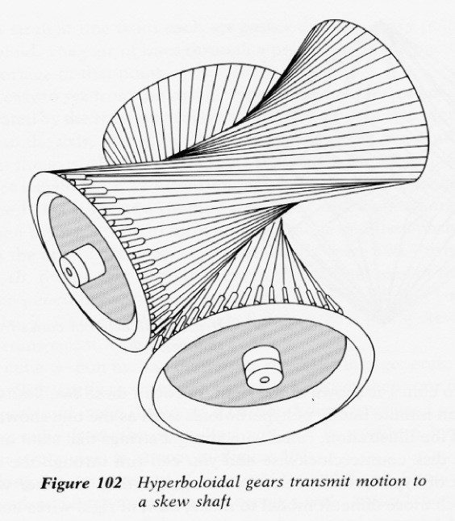
Hyperboloidal Gears

Slide 13
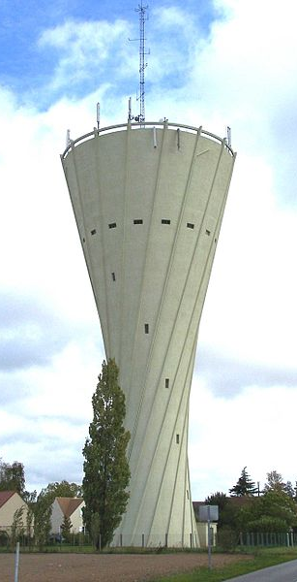
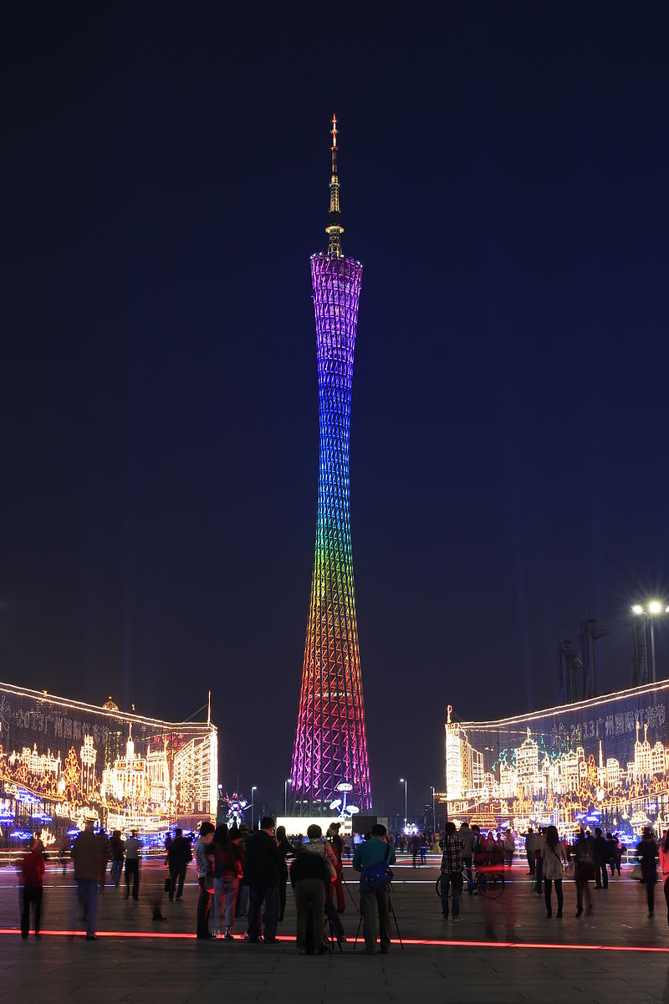
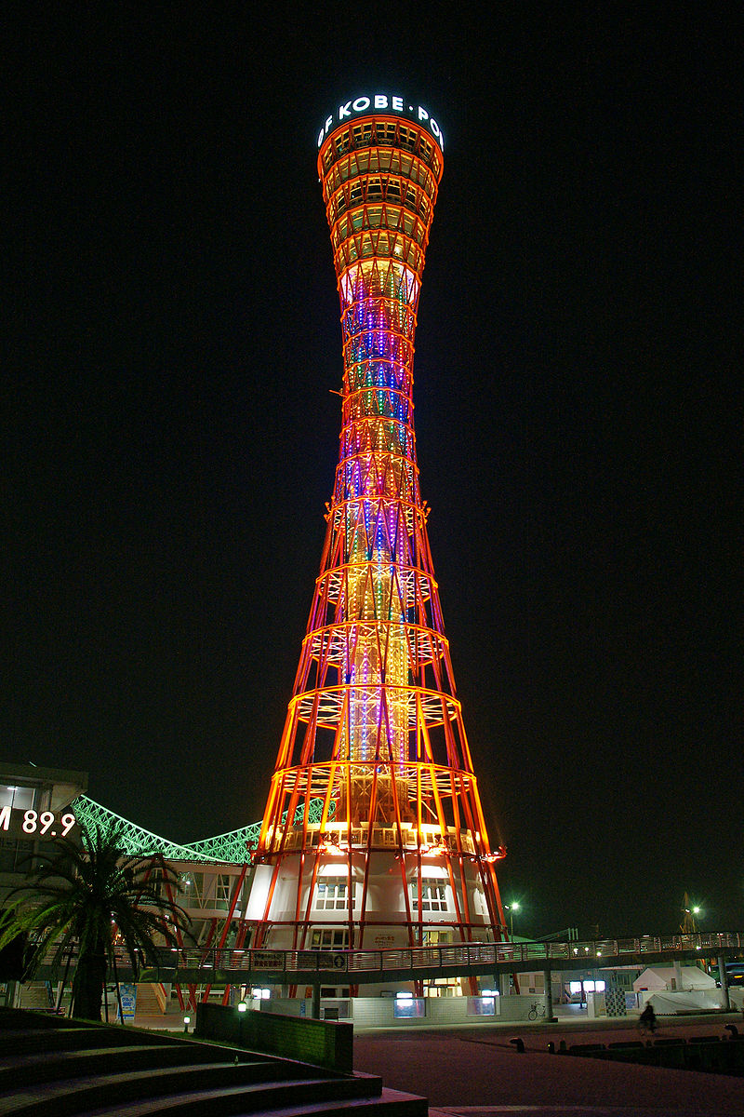
Hyperboloid Structures
Château d'eau de Les Essarts-le-Roi
Canton Tower
Kobe Port Tower

Slide 14
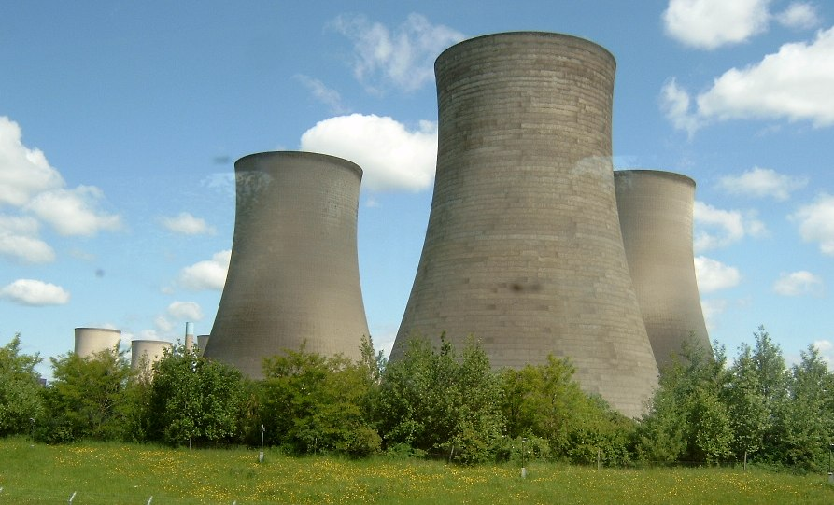
Hyperboloid Cooling Towers

Slide 15
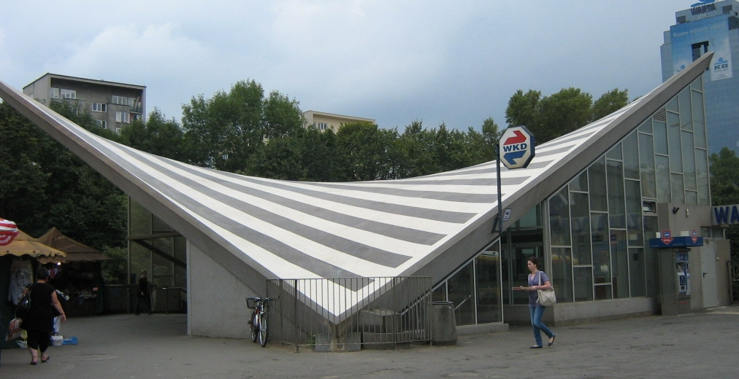
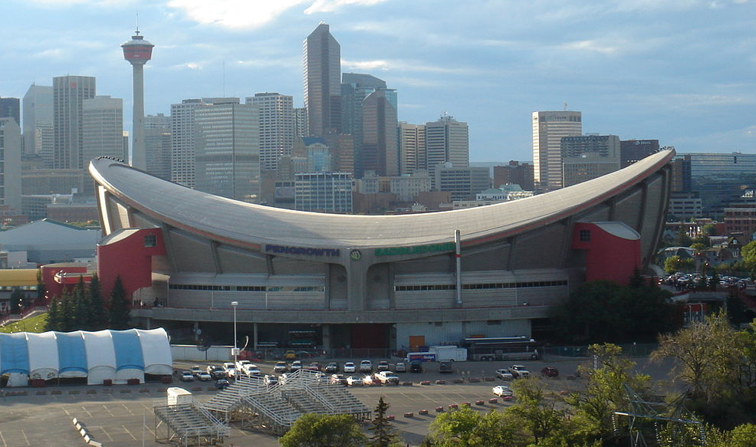
Hyperbolic Paraboloid Structures
Scotiabank Saddledome
Warszawa Ochota train station

Slide 16
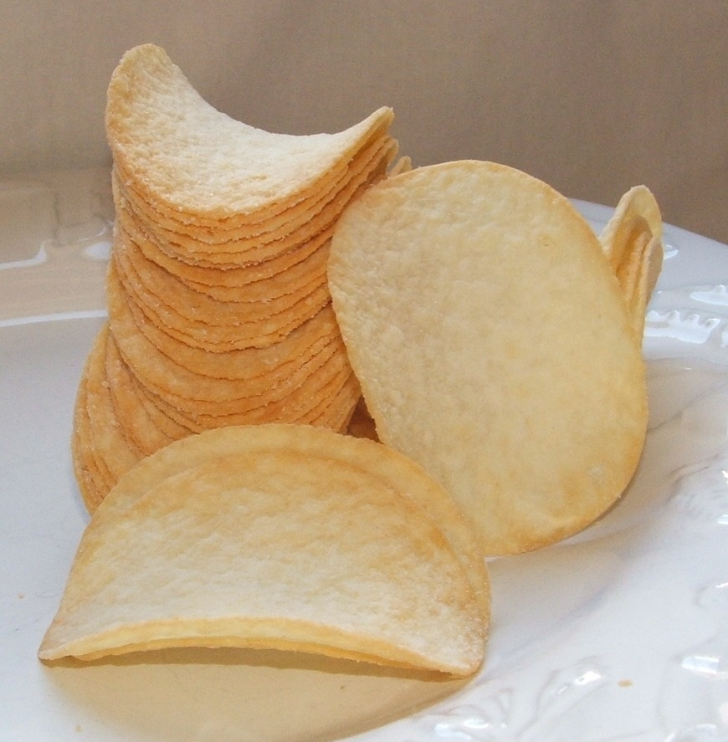
Pringles

Slide 17
Applications of Vector Valued Functions

Slide 18
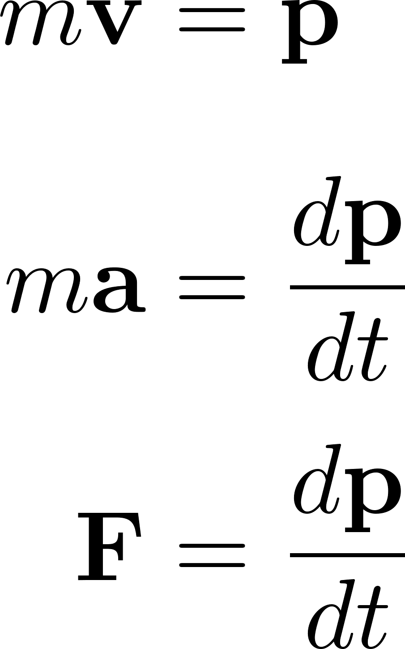
Newton’s Second Law

Slide 19
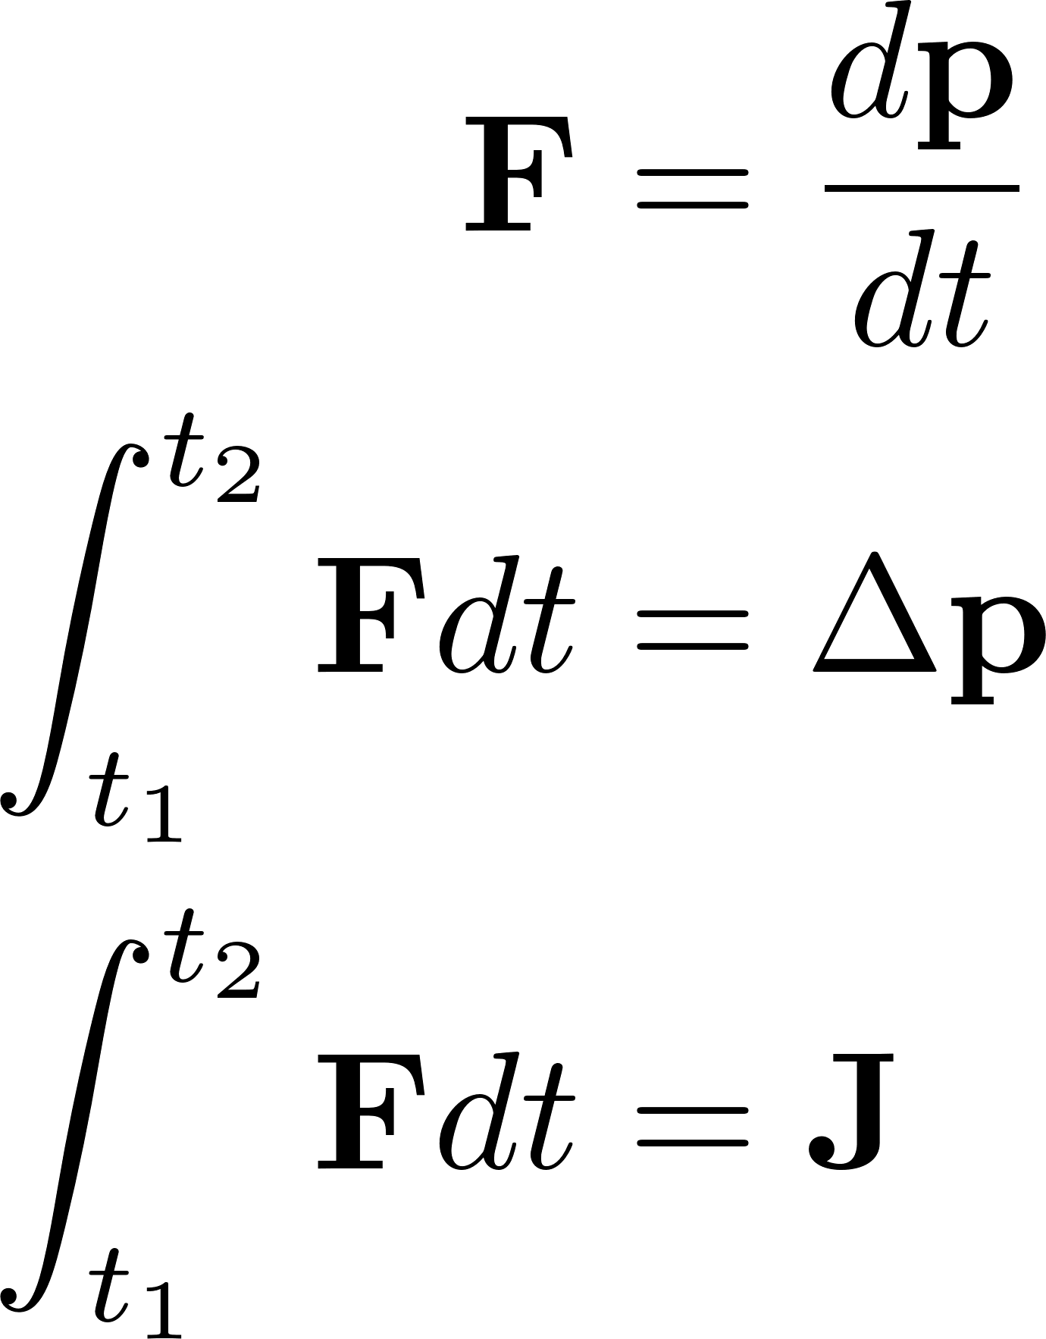
Impulse

Slide 20
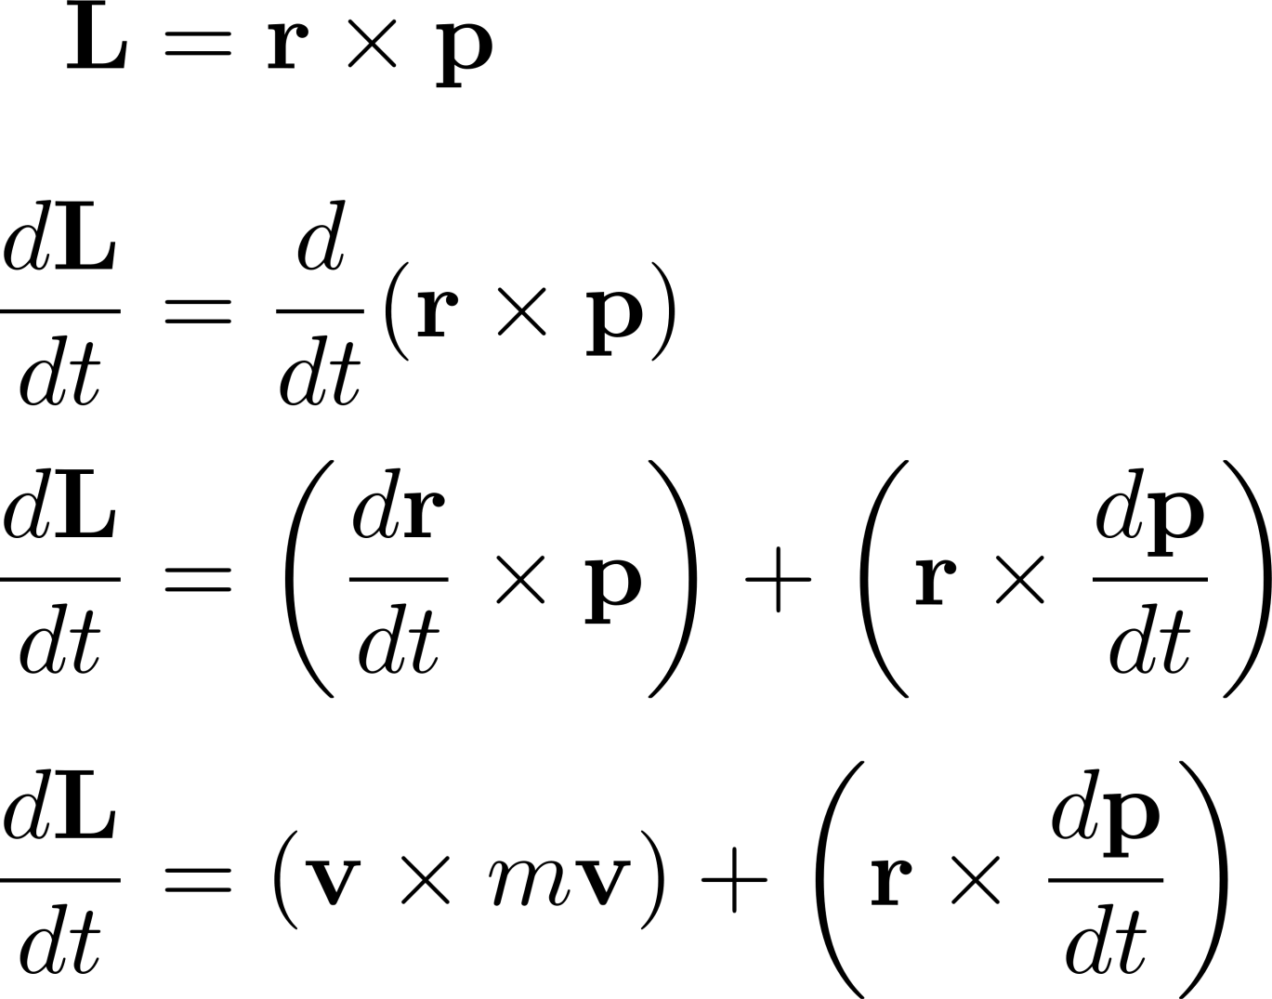
Angular Momentum

Slide 21
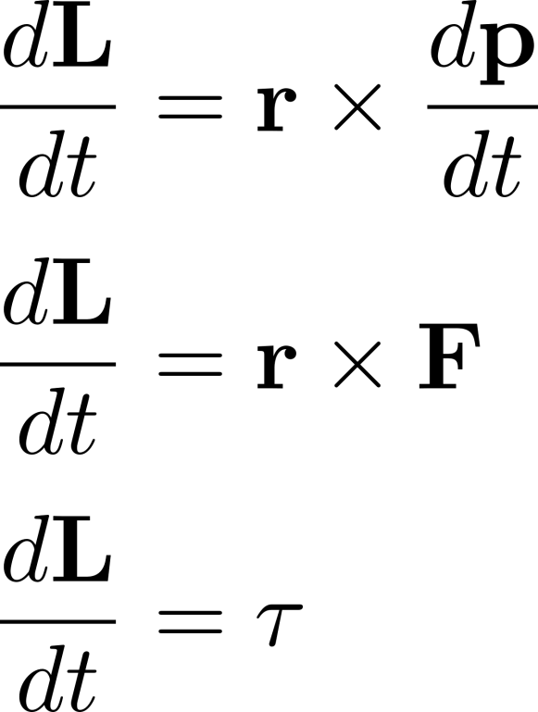
Torque

Slide 22
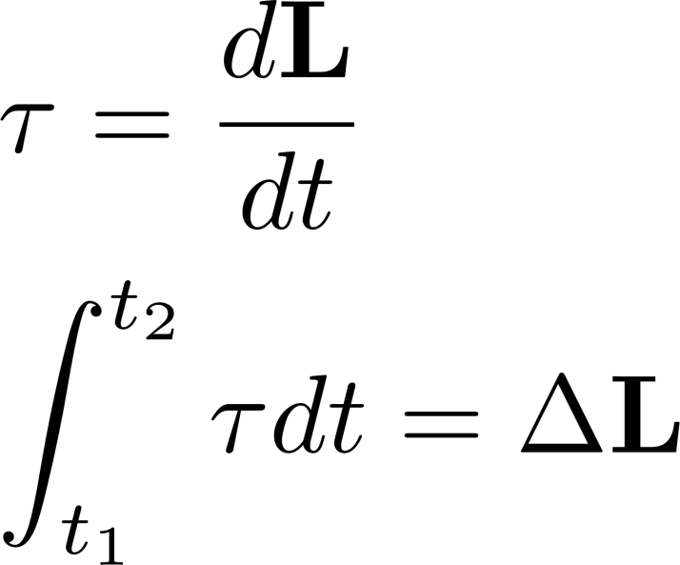
Angular Impulse

Slide 23
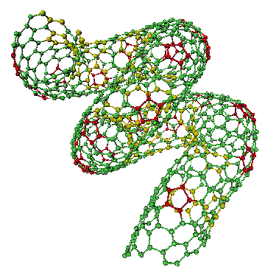
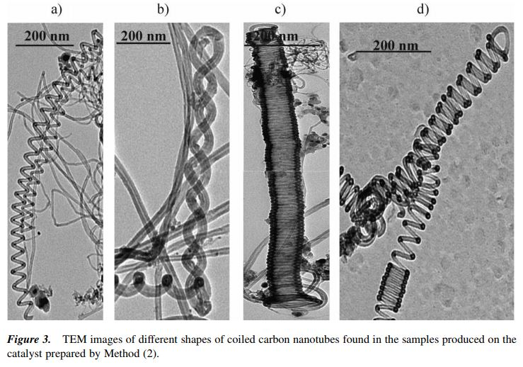
Carbon Nanotubes

Slide 24
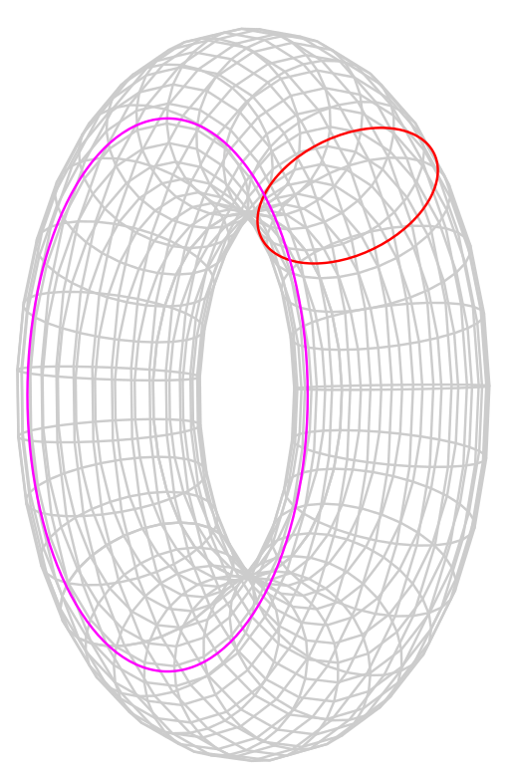
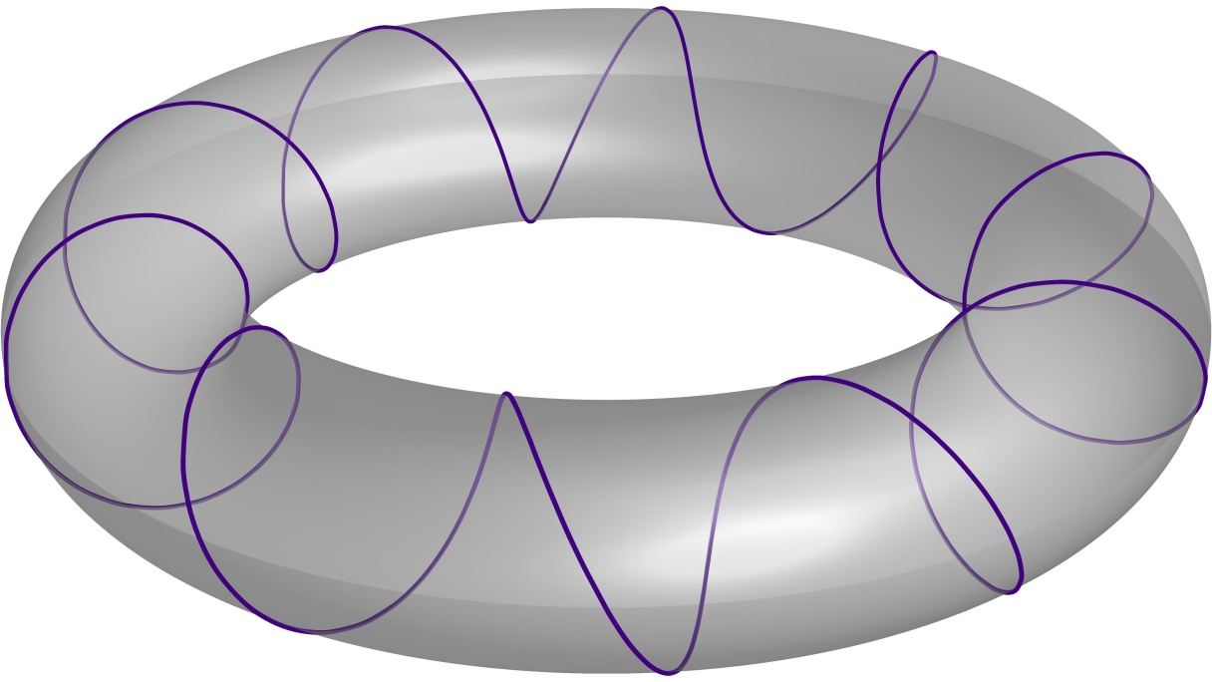
Tori & Toroidial Helixes

Slide 25
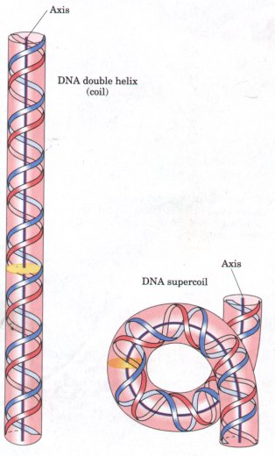
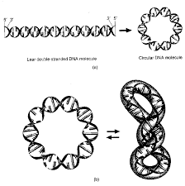
DNA Supercoiling

Slide 26
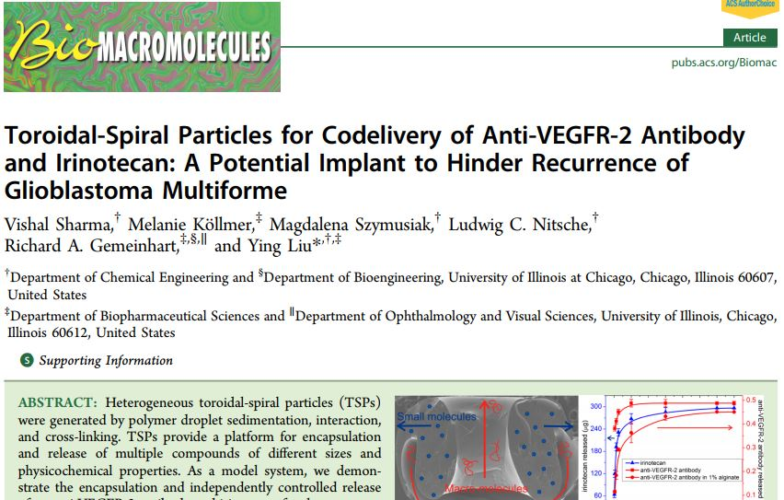
In Biomedical Research

Slide 27
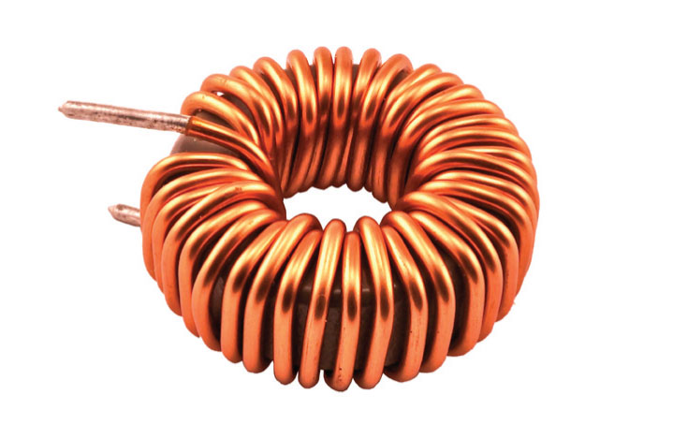
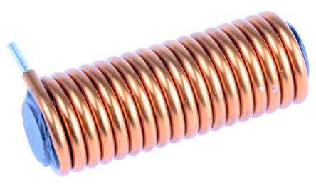
Inductors (and Transformers)

Slide 28
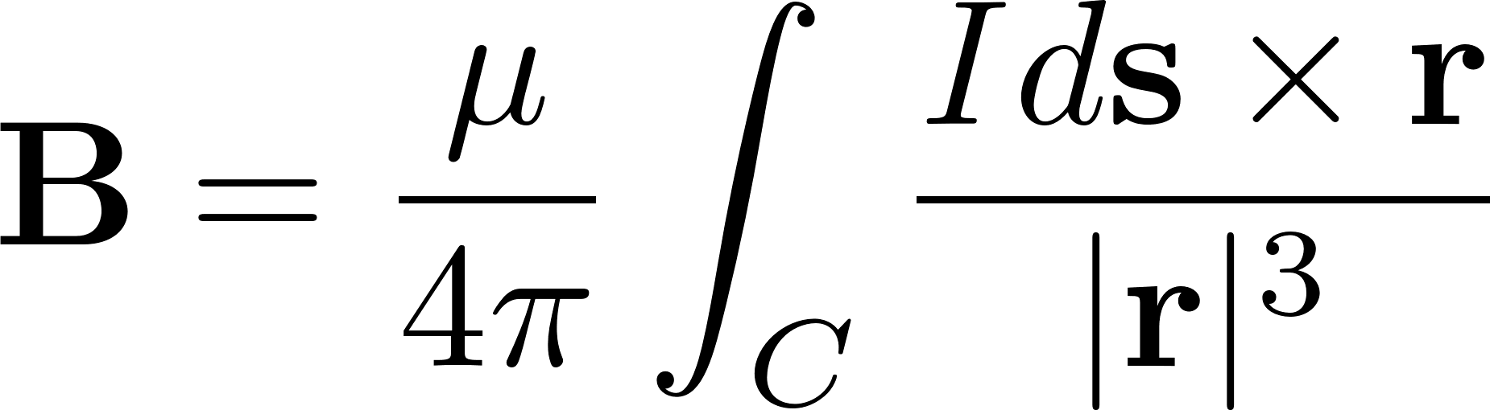
Biot-Savart Law

